Slide 1

Day of empire: how hyperpowers rise to global dominance – and why they fall
Presentation by Professor Amy Chua,
Yale Law School
September 24, 2019

Slide 2
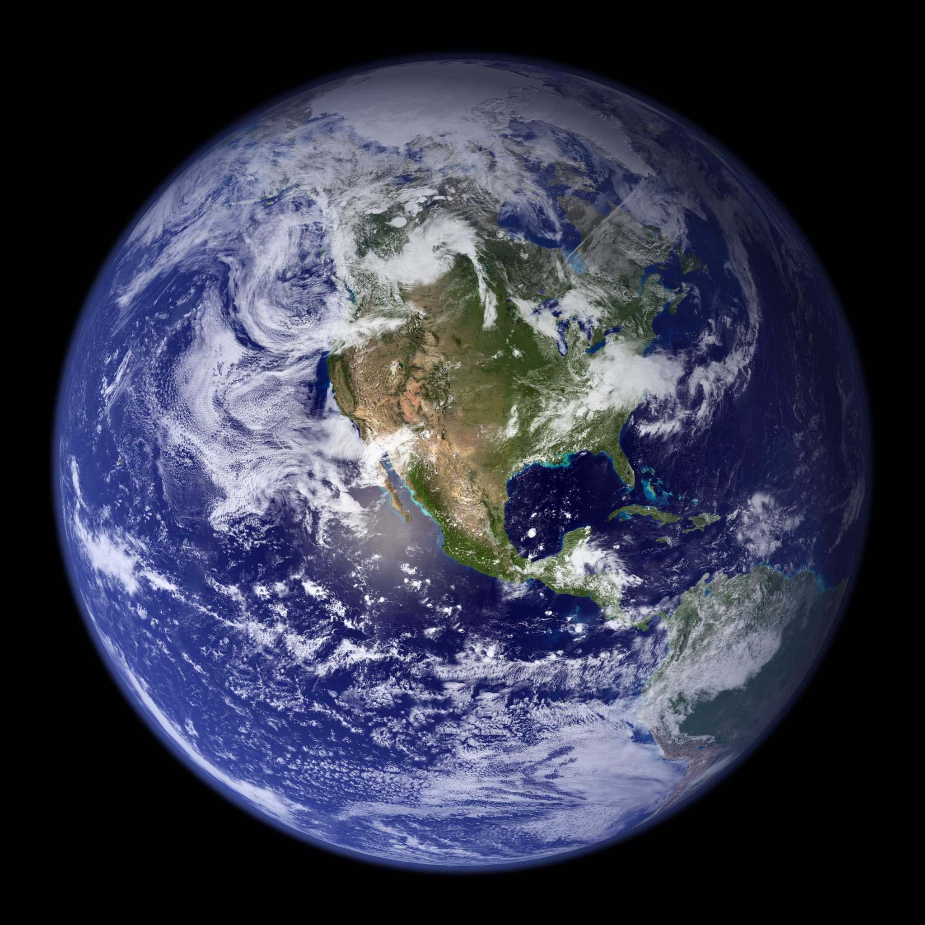
Definition of “hyperpower”
A hyperpower is not ….
Just a local power
Just a regional power
Just a superpower
A hyperpower is a world dominant power
Military and economic strength surpassing that of all its rivals
Projecting its power over a vast portion of the world

Slide 3

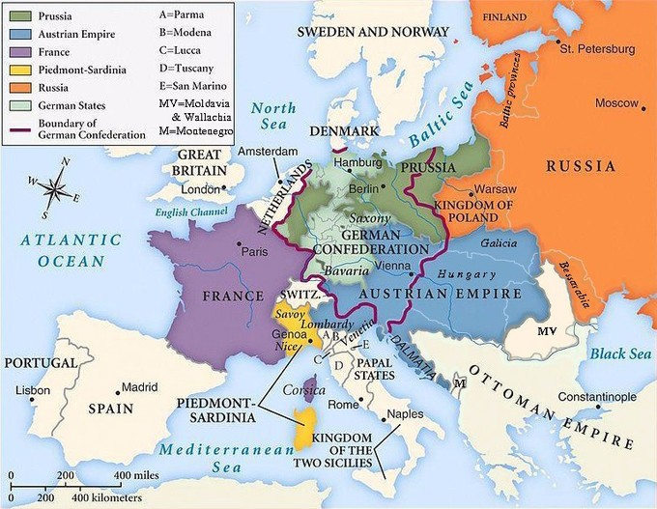

Hyperpowers are extremely rare
There have been fewer than 10 hyperpowers in human history…
…a multipolar world is much more common

Slide 4
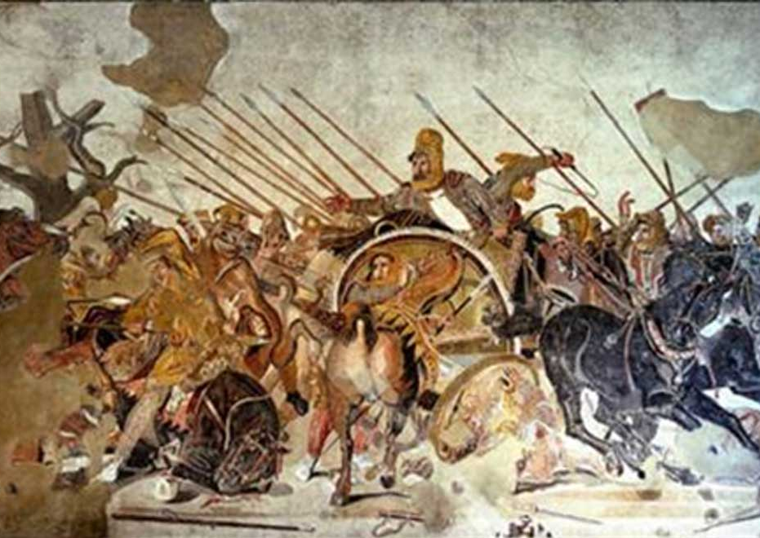



Some of history’s hyperpowers
Achaemenid Persia (now Iran): 550 – 330 B.C.
Rome’s High Empire: c. 98 – 200 A.D.
China’s Tang Dynasty: c. 618 – 907 A.D.
Dutch World Empire: c. 17th century A.D.
British Empire: c. 19th century A.D.
United States: 1989 - ?

Slide 5
A remarkable pattern
Every hyperpower in history was strikingly tolerant and pluralistic during its rise to preeminence
Conversely, the decline of hyperpowers has repeatedly coincided with intolerance and xenophobia
But note: It was “too much tolerance” that sowed the seeds of decline

Slide 6
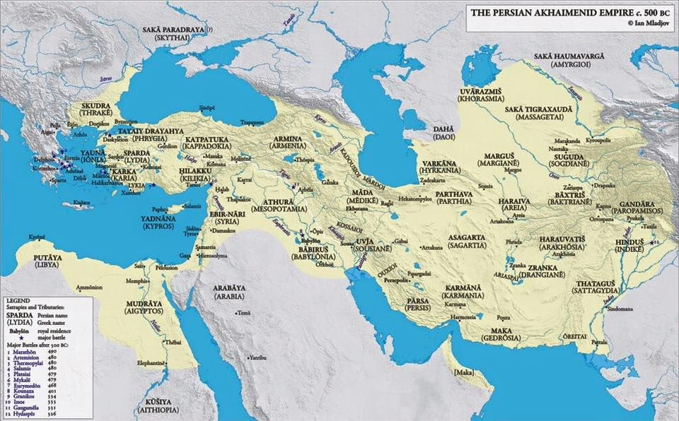
The Achaemenid Persian Empire
Founded by Cyrus the Great c. 550 B.C.

Slide 7
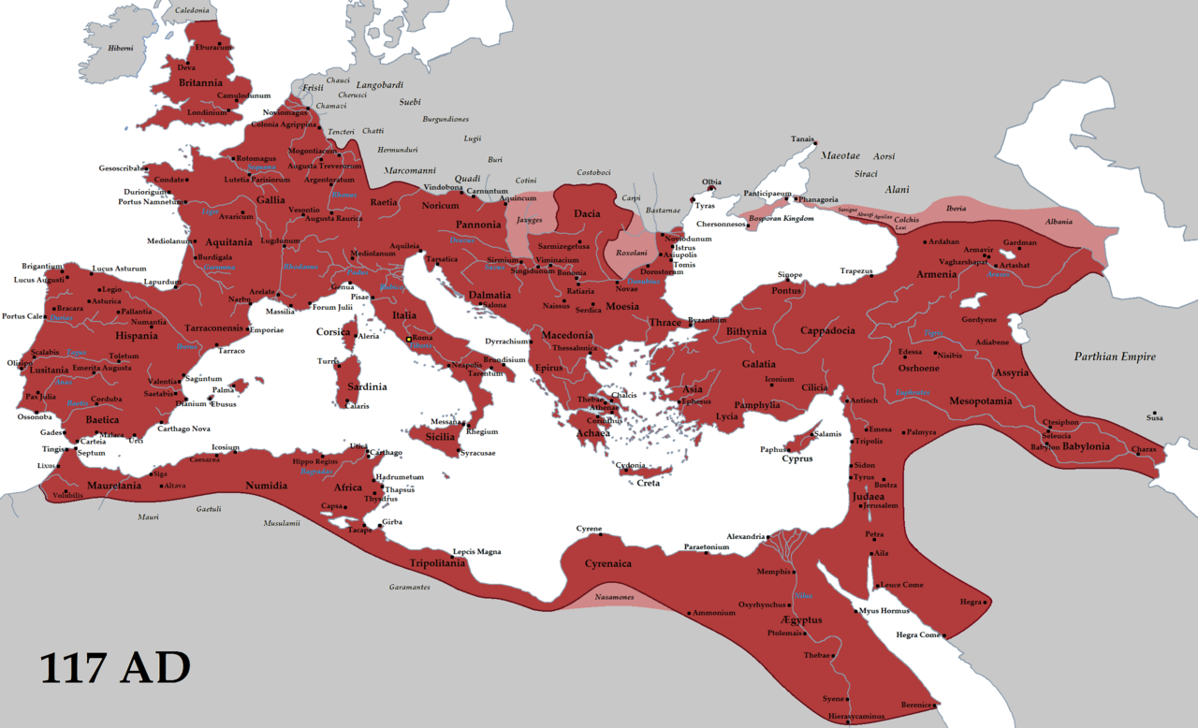


Rome’s High Empire
c. 98 – 200 A.D.

Slide 8
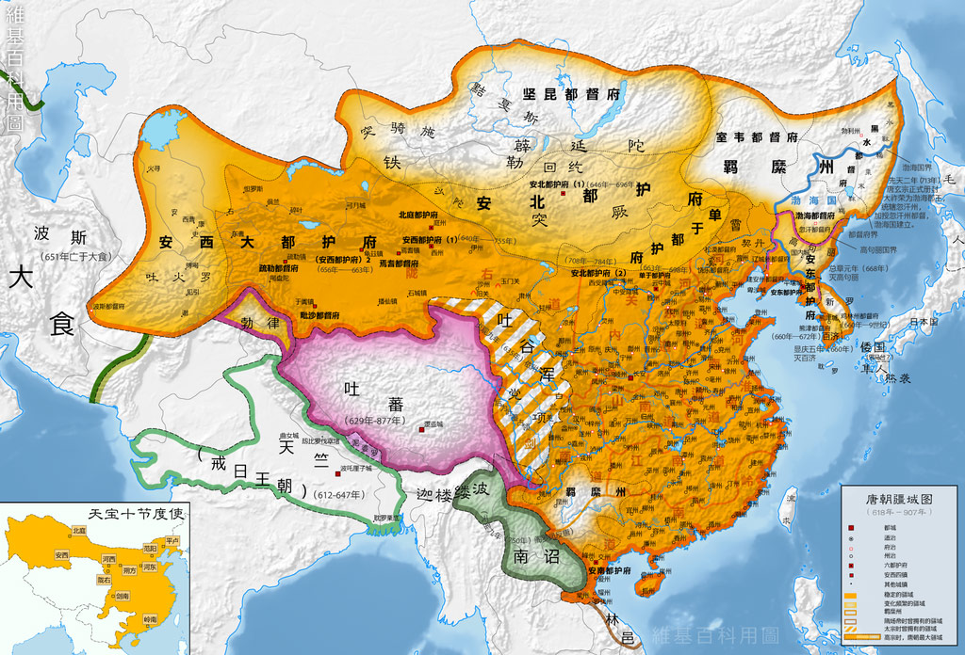

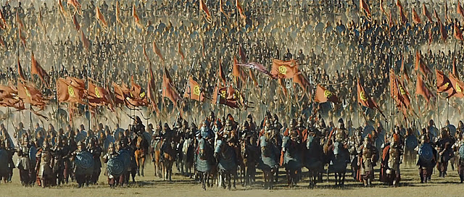
China’s Tang Dynasty
c. 618 – 907 A.D.

Slide 9
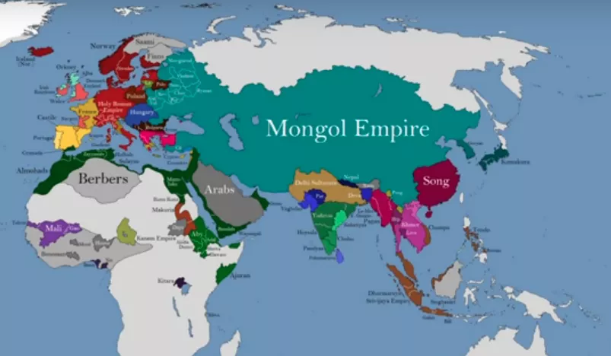

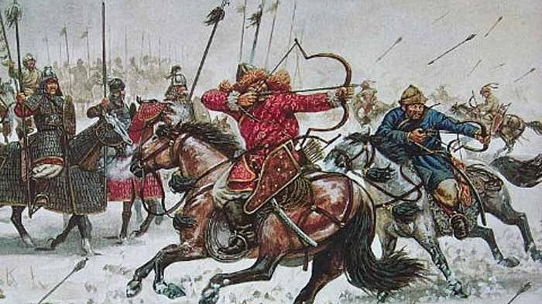
The Mongol Empire (China’s Yuan Dynasty)
c. 13th Century A.D.

Slide 10
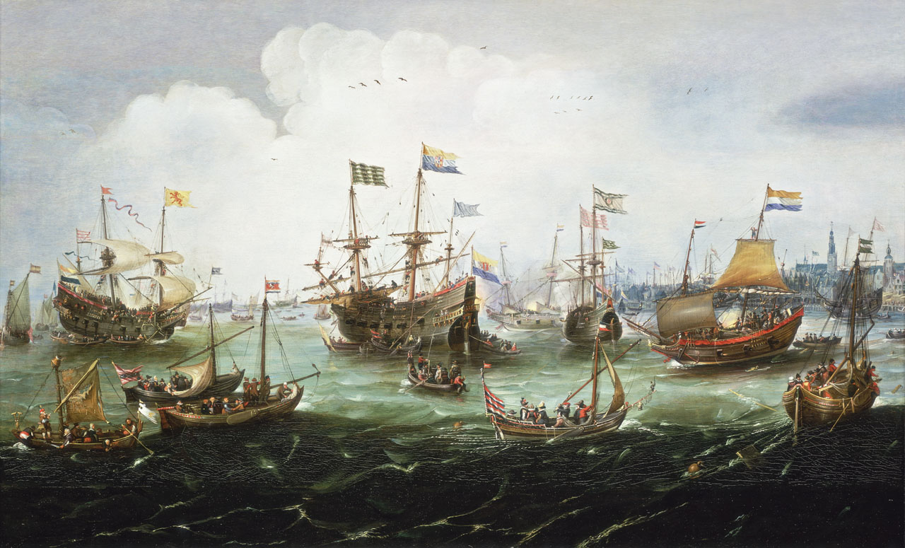
The Dutch World Empire
c. 17th Century A.D.

Slide 11
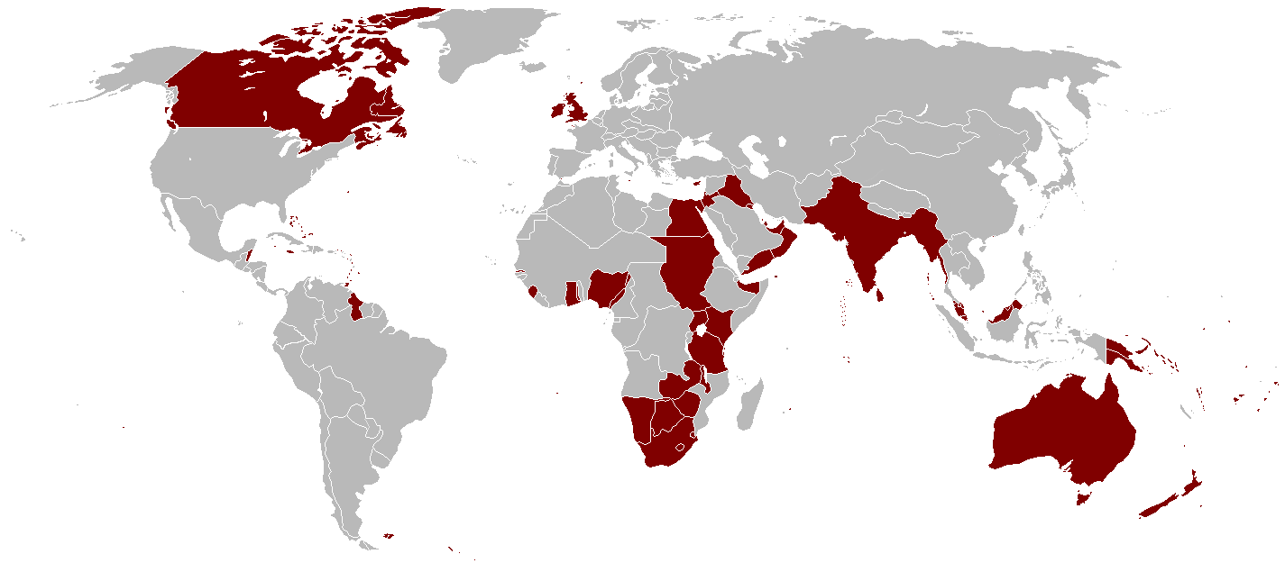
The British Empire
c. 19th Century A.D.

Slide 12
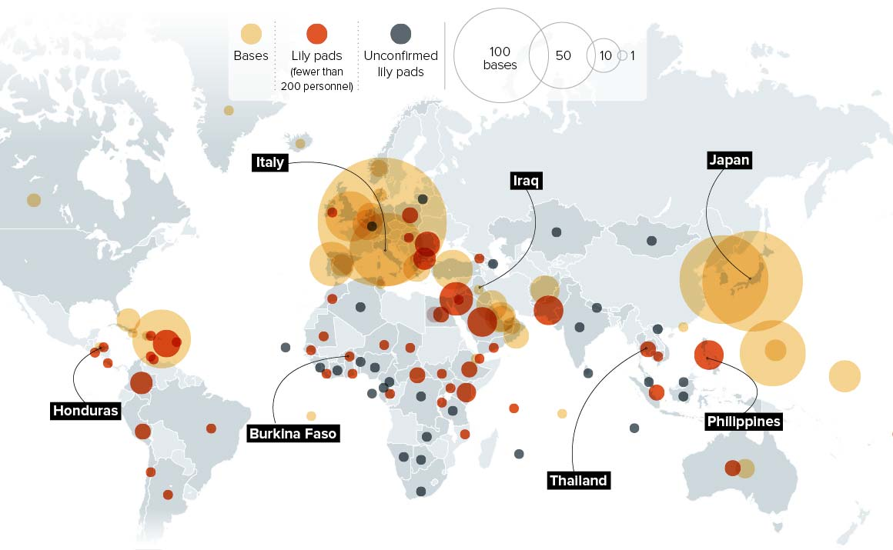
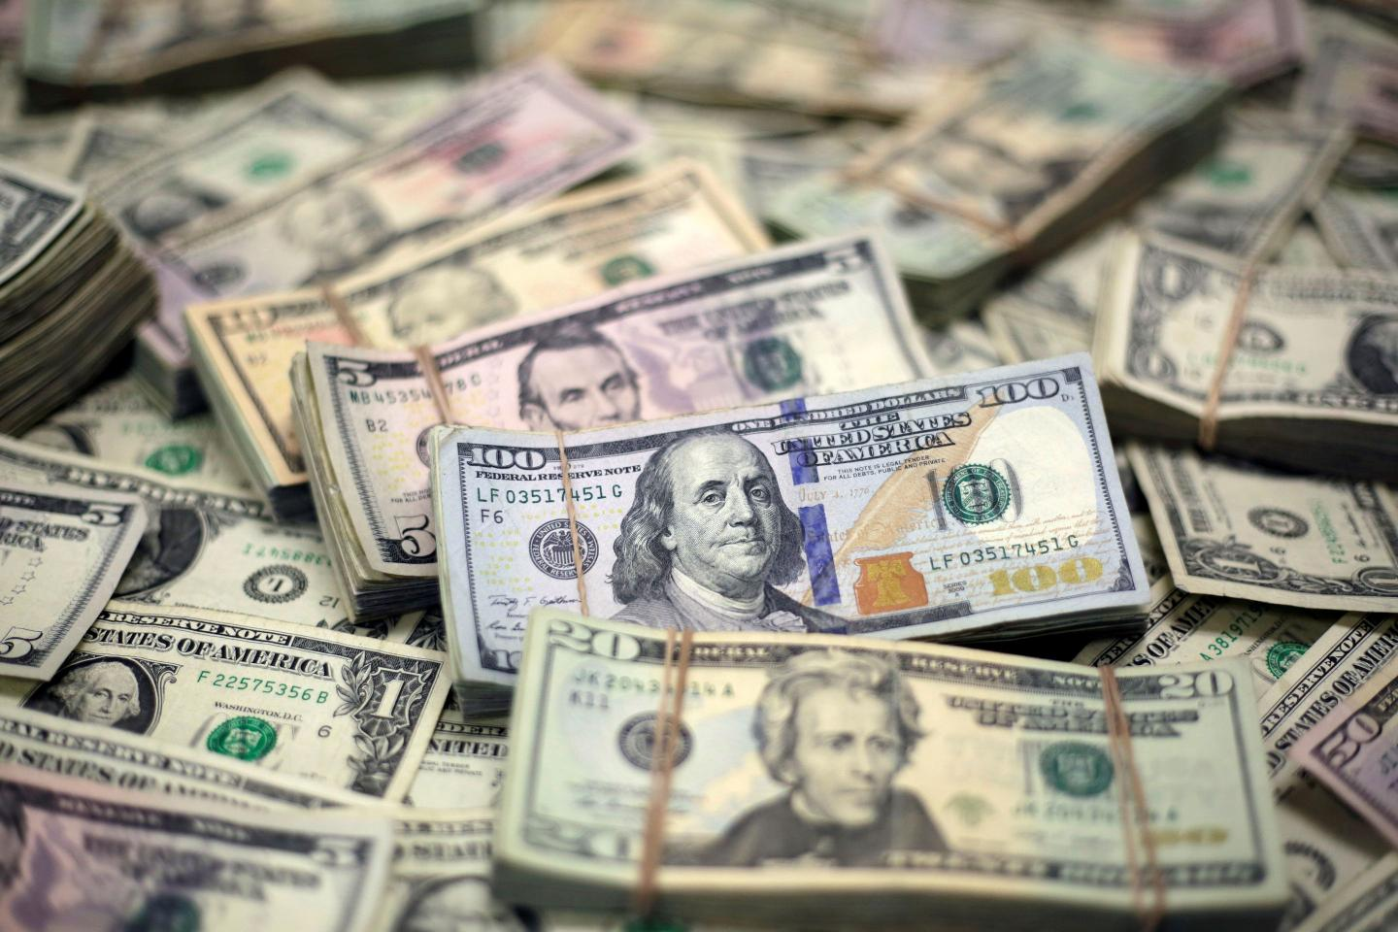
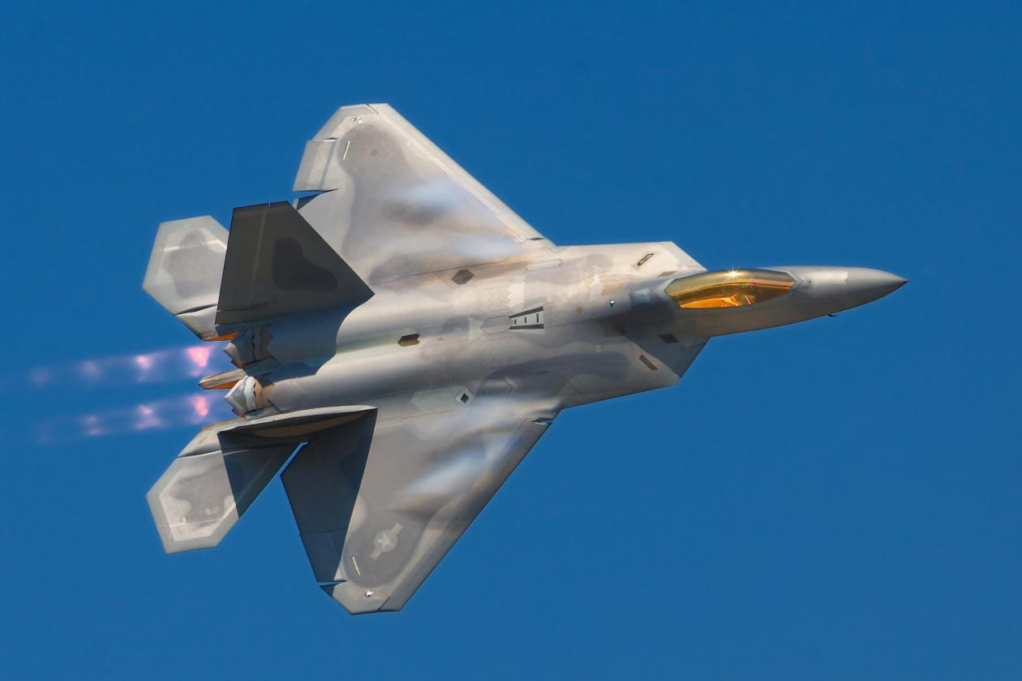
The United States
1989 - ??

Slide 13
Arguments the U.S. is a hyperpower
Military dominance
Total military spending = $801B. More than the next nine countries combined (China, India, UK, Russia, France, Germany, Saudi Arabia, Japan, and South Korea = $777B)
Economic dominance
Total GDP: $23.32 trillion. ~24% of the entire world’s economy. Next largest is China ($17.73 trillion)
GDP per capita: $73,249 (China: ~$12,556)
Dollar as global reserve currency: Roughly 60% of world’s foreign bank reserves are denominated in dollars, and nearly 40% of world’s debt is in dollars
Cultural dominance
More top universities than any other country
Global influence of America’s film, television, and digital sectors
Home to Silicon Valley and tech giants like Apple, Google, and Facebook
Notes:
Military spending figures: Stockholm International Peace Research Institute, 2021 figures current as of April 2022 (https://www.sipri.org/sites/default/files/2022-04/fs_2204_milex_2021_0.pdf)
GDP/GDP per capita figures: World Bank, 2021 figures are most recent
Reserve Currency figures: Federal Reserve, current as of October 2021 (https://www.federalreserve.gov/econres/notes/feds-notes/the-international-role-of-the-u-s-dollar-20211006.html)

Slide 14
Arguments the U.S. is not a hyperpower
Military limits
Russia and China both engaging in significant military modernization
Despite U.S. military superiority, use and deployment limited
Unable to deter or swiftly end Russo-Ukrainian War
Lagging behind Russia and China in cyber warfare development
Unable to force the denuclearization of Iran or North Korea
Economic limits
Increase in Chinese economic power relative to U.S.
Growth of Chinese investment and influence in Global South
China may be outpacing U.S. in high tech (5G, robotics, AI, etc.)
China is leading the world in manufacturing while US manufacturing fell 33% over the last two decades
Decline of soft power and international reputation
Image of disunity: 74% of international community sees US as divided
Failure in Afghanistan: 57% believe U.S. withdrawal from Afghanistan was handled poorly
Declining worldwide reputation under Trump and now under Biden?
Notes:
GDP data: Statistics have slowed, so I omitted. However, according to the World Bank, China’s growth was 8.1% and U.S. was 5.9% in 2021.
Infrastructure: https://www.bloomberg.com/news/articles/2022-04-06/china-infrastructure-push-dwarfs-u-s-spending
Manufacturing and trade deficit statistics: Adler and Breznitz, American Affairs; Robert E. Scott and Zane Mokhiber, “Growing China Trade Deficit Cost 3.7 Million American Jobs between 2001 and 2018,” Economic Policy Institute, January 30, 2020 (https://americanaffairsjournal.org/2021/11/the-reshoring-imperative/)
Soft power figures: Pew Research Center, current as of June 2022 (https://www.pewresearch.org/global/2022/06/22/international-public-opinion-of-the-u-s-remains-positive/)

Slide 15
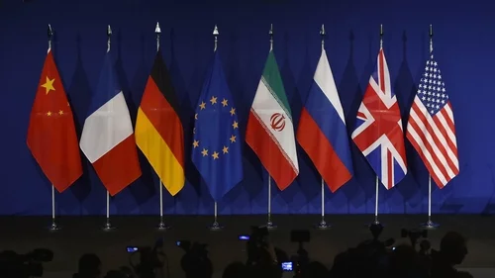
Back to a multipolar world?

